Slide 1
Enhanced NCNP Detector for 5G waveform using Cognitive Radio during Disasters
Final Review
UNDER THE GUIDANCE OF:
Name of the Supervisor: Ms. M. Ramya, M.E.,
Designation: Assistant Professor
PROJECT STUDENTS:
Reg.No. | Name of the Student
71762104023 | KAVIYA V
71762104029 | MEENAKSHI S NAIR
71762104030 | NANDHA SRI S N
71762104031 | NANDHINI P

Slide 2
INTRODUCTION & NEED FOR THE PROJECT
INTRODUCTION:
India often faces natural disasters that disrupt communication networks and affect millions annually. With the expansion of 5G technology, efficient spectrum utilization is crucial, especially for disaster management. Traditional allocation methods are inadequate in these dynamic situations, resulting in inefficient channel use.
NEED FOR THE PROJECT:
Ensure reliable spectrum management and sharing for uninterrupted communication.
Optimize 5G networks in real-time to prioritize emergency traffic.
Support seamless inter-agency communication for effective disaster response
and coordination.

Slide 3
PROBLEM STATEMENT & OBJECTIVE
PROBLEM STATEMENT:
Natural disasters often disrupt communication systems, causing delays and inefficiencies in emergency responses. Rescue teams face unreliable channels and congestion, while drones and disaster centers struggle with limited bandwidth and spectrum inefficiencies. Emergency centers also experience difficulties in managing 5G spectrum, leading to inefficient utilization and interference.
OBJECTIVE:
To implement a cognitive radio network to sense the unused spectrum and to allocate the detected unused spectrum to secondary users that prioritizes the emergency centers.

Slide 4
LITERATURE SURVEY
S.No. | Paper Title | Methodology/ Algorithm | Outcome | Merits & Demerits
1. | D. Jiang, J. Hu, Y. Zhang, L. Wang, and S. Xu, (2024), "Enhancing 5G Spectrum Sensing: Noncoherent Neyman–Pearson Detector Design and Interference Suppression Method," IEEE Transactions on Instrumentation and Measurement, vol. 73, pp. 1-15. | TDL channel model for detecting weaker 5G signals under multipath interference. SRIS Suppresses interference DFT-Based Channel Estimation | Achieves 97% detection accuracy at 10 dB SNR. Noise mitigation using DFT and OTA tests validations | Merits Weaker signals detected despite strong interference. Scalable under dense 5G network. Demerits Requires precise setup for SRIS and TDL models. Challenges in high Doppler shift environments​
2. | J. Manco and I. Dayoub, (2024), "Experimental Assessment of Spectrum Sensing Under Time-Varying Channels for Cognitive Radio," IEEE Sensors Letters, vol. 8, no. 8, pp. 1-4. | Spectrum Sensing in mobile, time-varying channels. Emulation using SDR; MSEE detector assessment. | 8.3% detection loss with 50% reduced sensing period. 6.6% performance drop under high Doppler effects. | Merits Realistic evaluation in challenging environments. Demerits Performance drops under high Doppler and short sensing periods , complex and costly
DEPARTMENT OF ELECTRONICS AND COMMUNICATION ENGINEERING

Slide 5
LITERATURE SURVEY
S.No. | Paper Title | Methodology/ Algorithm | Outcome | Merits & Demerits
3. | Sandip B. Shrote and Sadhana D. Poshattiwar, (2024), "Dynamic Spectrum Sensing for 5G Cognitive Radio Networks Using Optimization Technique," IEEE Journal of Electrical Systems, vol. 20,no. 30, pp. 1221-1231. | Deep Learning Integration MIMO-Based Spectrum Sensing Feedback Artificial Optimization Algorithm-based Deep Q Network | Achieved 70% detection probability and 38% false alarm rate in Rayleigh channels. | Merits High accuracy in spectrum detection. Enhanced spectral efficiency in 5G networks. Demerits High computational complexity. Challenges in practical implementation and interference management.
4. | K. Wang, G. Ma, Y. Ma, B. Feng, and B. Ai, (2024), "Spectrum Sensing Based on the Difference Between the Maximum Eigenvalue and the Geometric Mean of the Eigenvalue," IEEE Transactions on Vehicular Technology, vol. 20, no. 3, pp. 1221-1231. doi: 10.1109/TVT.2024.3393562 | CRDMGM algorithm cyclically reorganizes sampled signals to boost detection accuracy. Eigenvalue estimation under low SNR and few antennas. | Outperforms DMGM and IDMGM in accuracy, particularly under low SNR and with limited antennas. | Merits Enhanced detection performance with fewer antennas Improved eigenvalue estimation. Demerits Increased complexity due to cyclic reorganization.
DEPARTMENT OF ELECTRONICS AND COMMUNICATION ENGINEERING

Slide 6
INFERENCE FROM LITERATURE SURVEY
Non-Coherent Neyman Pearson (NCNP) Detector for Real-Time Applications:
NCNP offers simpler implementation compared to Deep Learning and Eigenvalue-based methods.
Deep Learning requires high computational resources, unsuitable for disaster scenarios.
Eigenvalue methods add processing overhead in low SNR conditions.
2. Lower Computational Requirements:
NCNP's design avoids heavy computation and large datasets.
It’s more efficient than Eigenvalue methods, making it ideal for real-time, low-power environments.
3. Balancing Accuracy and Simplicity
NCNP offers high detection accuracy with low complexity, key in disaster scenarios.
MIMO-based methods can suffer high false alarms, while Eigenvalue methods, though accurate, are too complex for real-time use.

Slide 7
INFERENCE FROM LITERATURE SURVEY
4. Practical Scalability
NCNP enables quick deployment with minimal calibration, ideal for large networks.
MIMO systems need heavy infrastructure, and Eigenvalue methods are hard to scale due to their complexity.
5. Robustness in Dynamic Environments
NCNP is reliable in changing conditions, crucial for disaster scenarios.
Deep Learning struggles in unseen environments, while Eigenvalue methods perform poorly under high Doppler effects.
Best Alternative
Enhancing NCNP detector using Cognitive Radio is the best alternative, balancing low complexity, accuracy, reliability and dynamic spectrum sensing for real-time emergency applications.

Slide 8
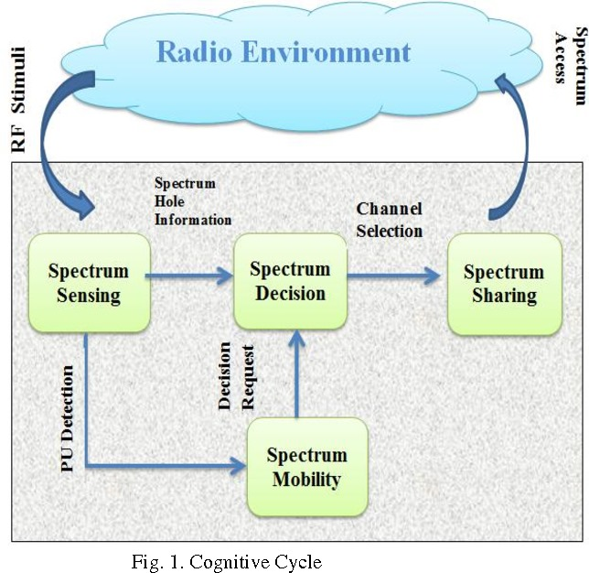
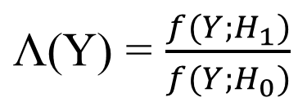

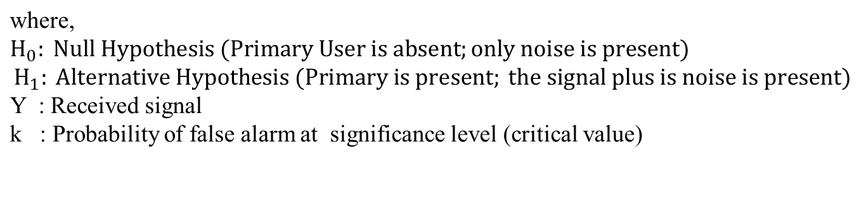
MATHEMATICAL MODEL
Neyman Hypothesis using Likelihood Ratio Test:
Fig 1: Cognitive Cycle

Slide 9



PROPOSED SYSTEM
5G User
Receiver
Antenna
COGNITIVE RADIO
RF Module
Non-Coherent Neyman Pearson Detector
Sub 6 GHz
PU Present
Transmitter
Antenna
Likelihood ratio test
5G Signal Generation
PU Absent
Fig.2 Block Diagram

Slide 10
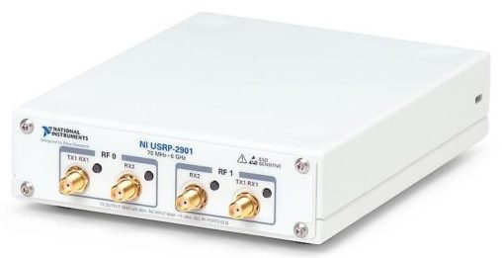
HARDWARE AND SOFTWARE USED
Hardware Requirements:
USRP – NI 2901 (70 MHz – 6 GHz)
Omni directional Antenna
Software Requirements:
LabView
Matlab
Fig.3 NI - USRP 2901

Slide 11
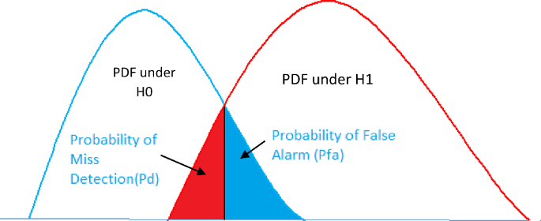
PARAMETERS
Parameters to be measured for the performance metrics,
1. Probability of Detection (Pd)
2. Probability of False Alarm (Pfa)
3. Probability of Miss Detection (Pm)
Fig.4. Spectrum Sensing using Cognitive Radio

Slide 12
NCNP DETECTION ALGORITHM
Step 1: Initialization
  Define the input data for QPSK or QAM modulation.
  Set transmission parameters like bit rate and carrier frequency.
Step 2: QPSK Modulation
  Convert data to Non-Return-to-Zero (NZR) format.
  Group data into 2-bit symbols for phase mapping.
  Generate in-phase and quadrature signals based on the phase.
  Combine the signals to form the QPSK or QAM modulated signal.
Step 3: Plot Modulated Signals
  Plot in-phase, quadrature, and combined QPSK or QAM modulated signals.
Step 4: QPSK or QAM Demodulation
  Extract in-phase and quadrature components from the received signal.
  Integrate and threshold components to recover original bits.
  Combine bits to reconstruct the transmitted data.

Slide 13
ALGORITHM
Step 5: Spectrum Sensing
  Simulate noise-only (H0) and signal-plus-noise (H1) cases.
  Compute energy under both hypotheses.
  Calculate detection threshold using Q-function.
Step 6: Performance Metrics
  Calculate probabilities of detection (Pd) and false alarm (Pf).
  Plot received signal energy and probability density functions.
Step 7: Results
  Display demodulated data, threshold, Pd, and Pf.
  Visualize key plots for modulation and spectrum sensing.

Slide 14
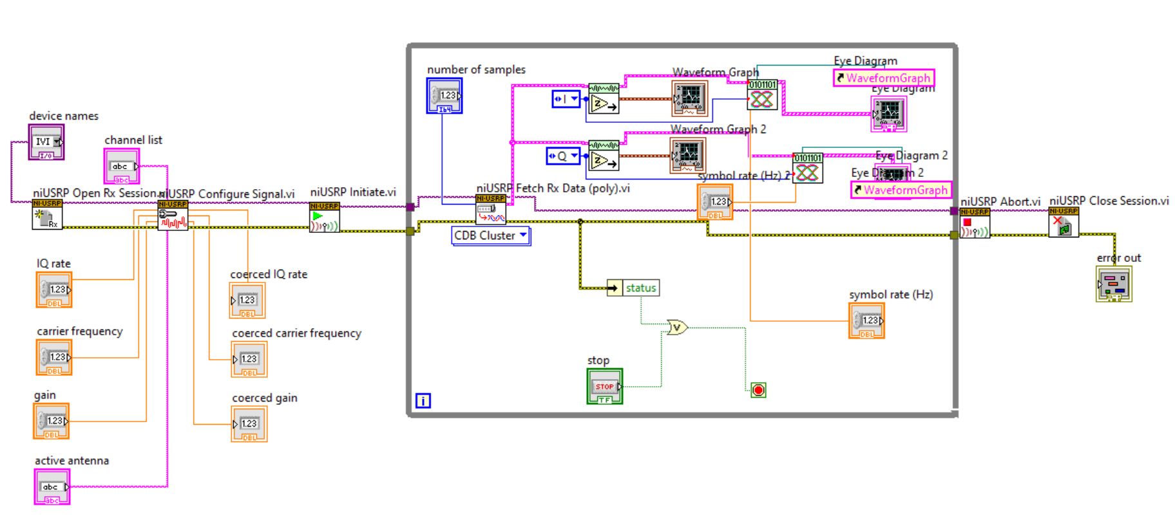
RESULTS - USRP RECEIVER
BLOCK DIAGRAM OF USRP RECEIVER DESIGN

Slide 15
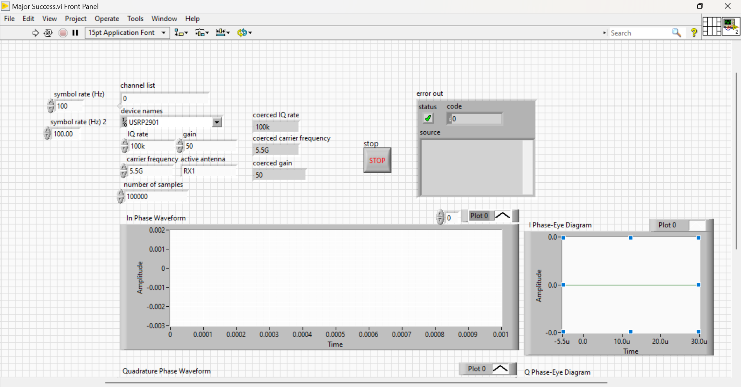
RESULTS - USRP RECEIVER FRONT PANEL
FRONT PANEL OF USRP RECEIVER DESIGN USING LABVIEW

Slide 16
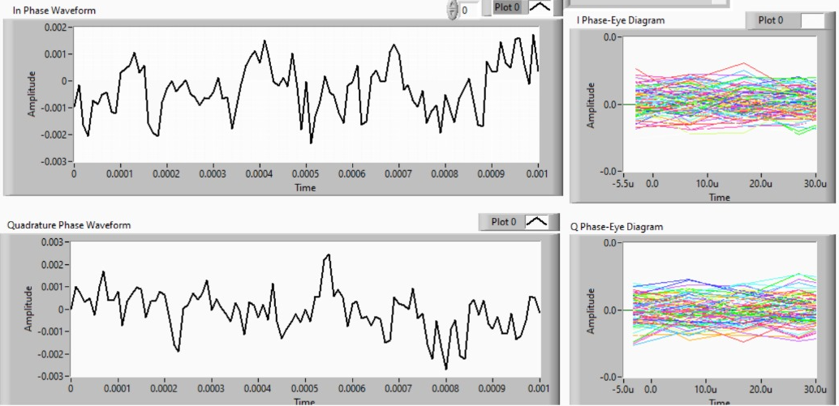
RESULTS - USRP RECEIVER FRONT PANEL
FRONT PANEL OF USRP RECEIVER DESIGN USING LABVIEW
Carrier Frequency : 5.5 GHz

Slide 17
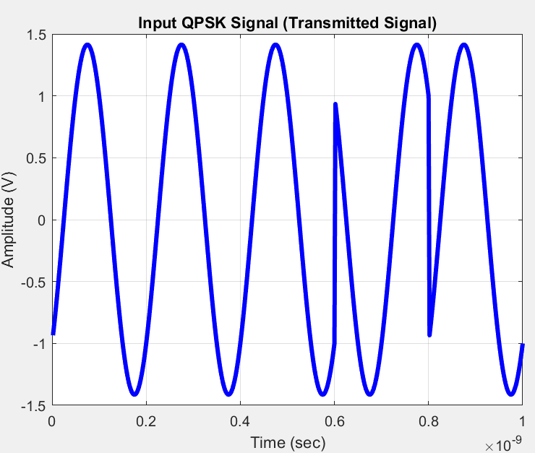
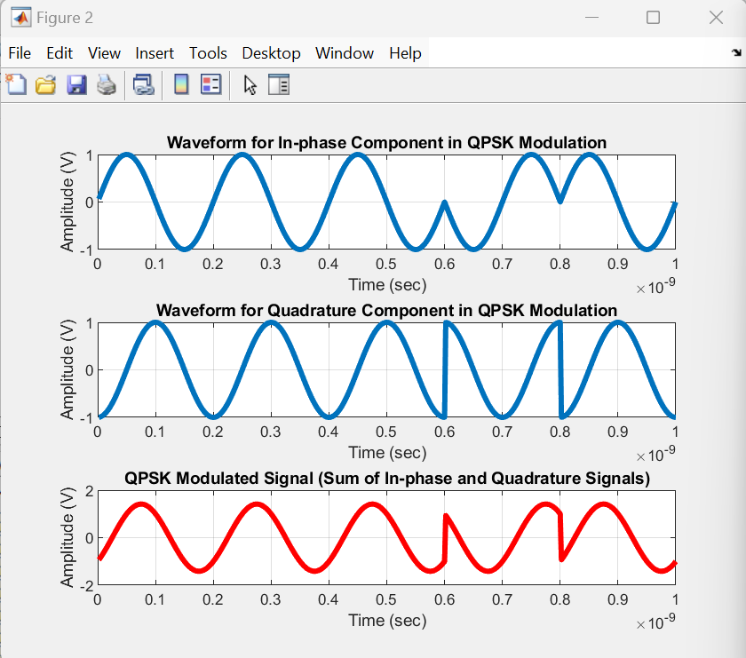
RESULTS - MATLAB
5G - QPSK Signal Generation

Slide 18
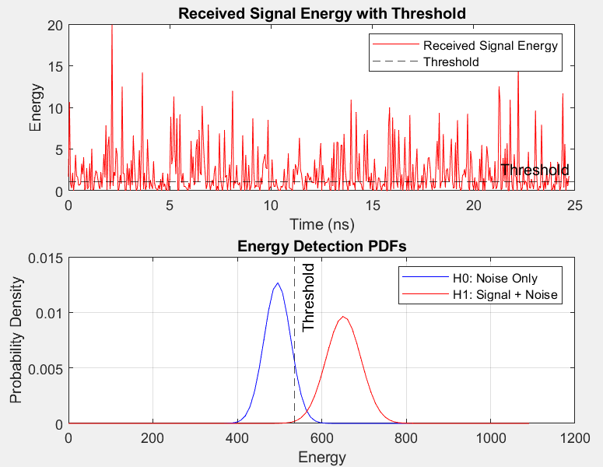
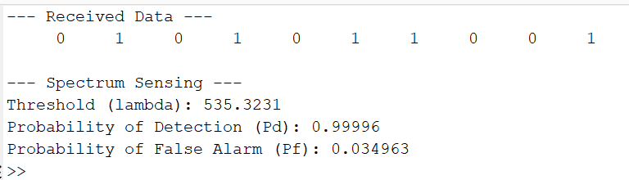
RESULTS - MATLAB
5G - QPSK Signal Reception

Slide 19
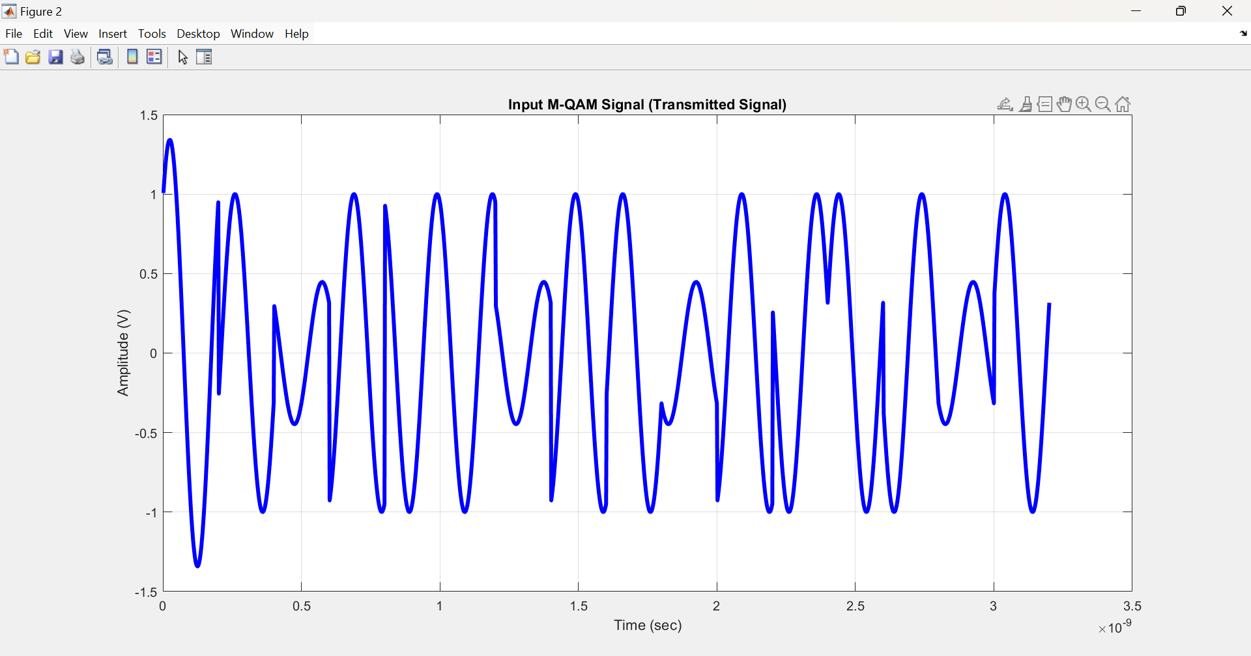
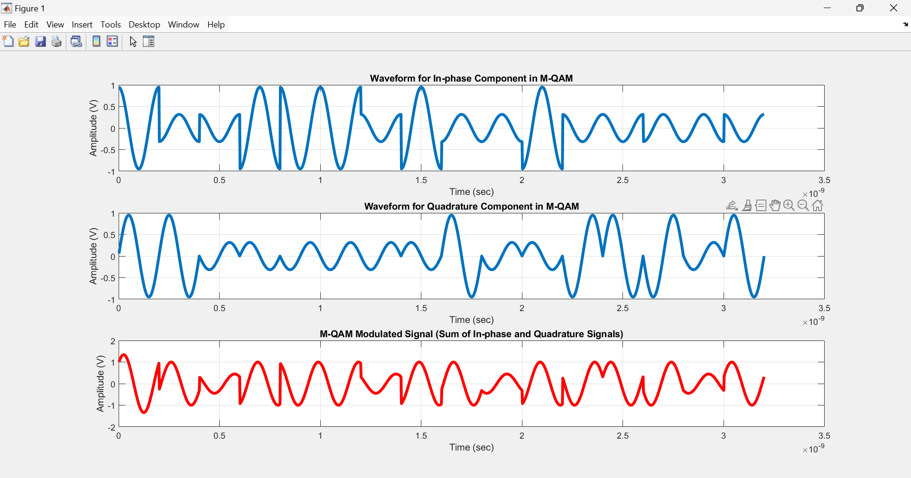
RESULTS - MATLAB
QAM Signal Generation

Slide 20
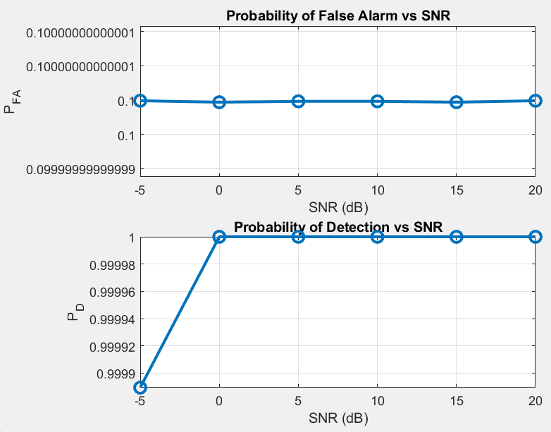
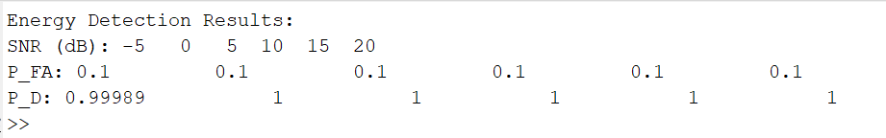
RESULTS - MATLAB
Plots of Pfa and Pd for varying SNR

Slide 21
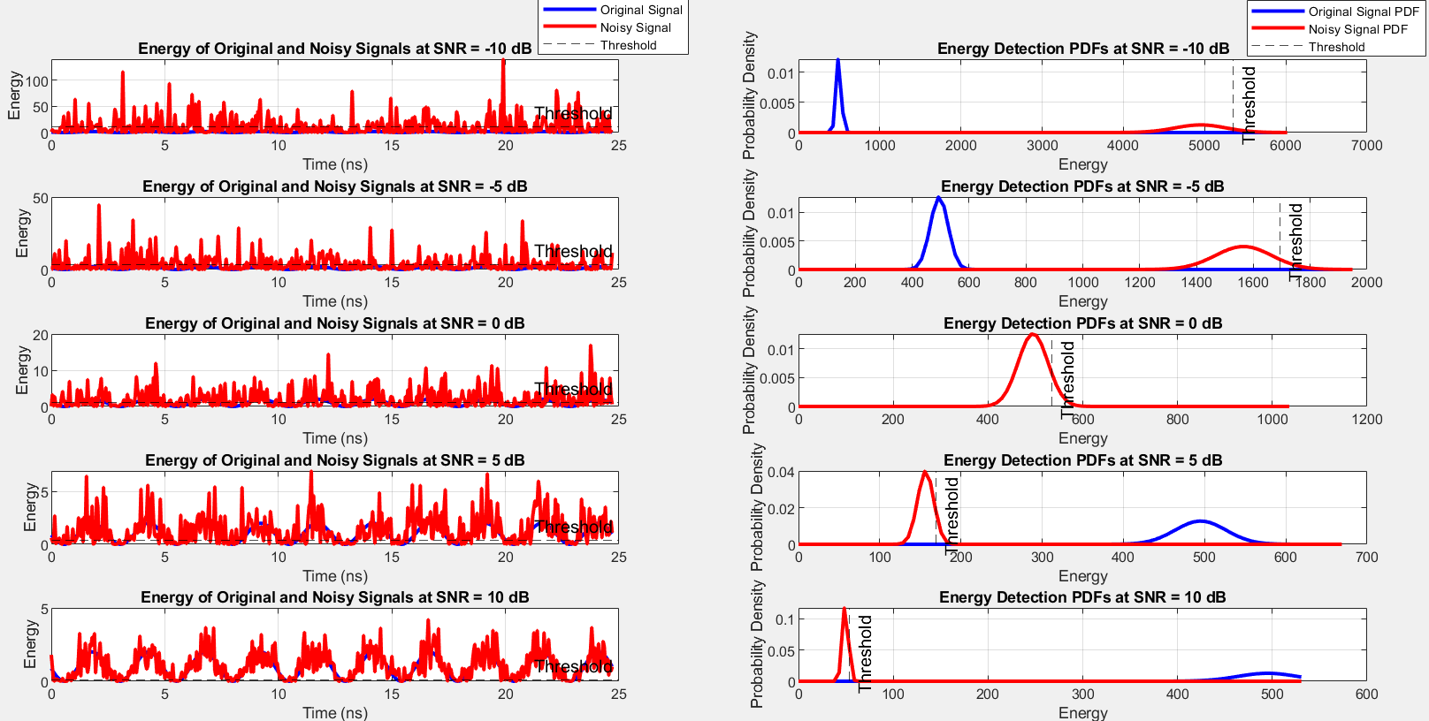
RESULTS - MATLAB
Plots of Energy Detection for varying SNR

Slide 22
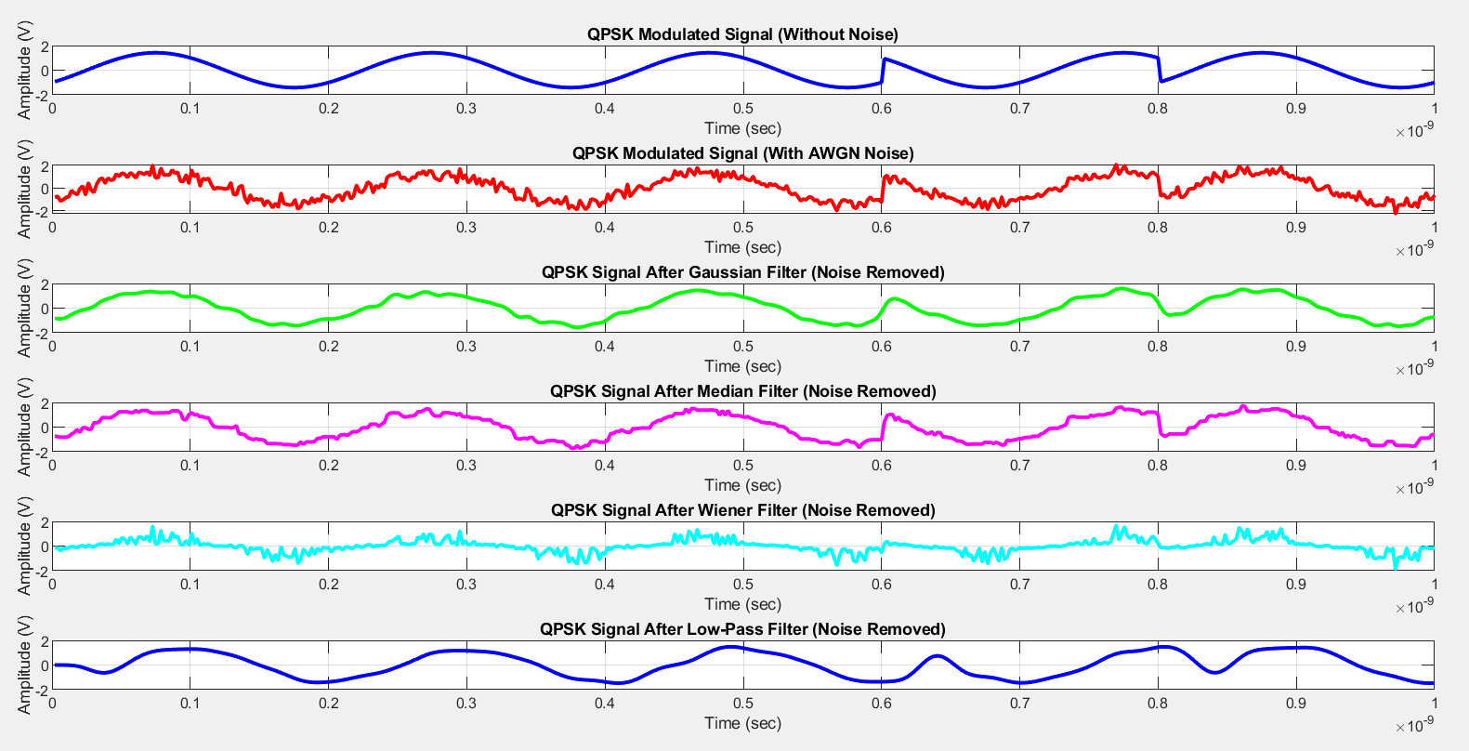
RESULTS - MATLAB
Comparison of Noise Filters

Slide 23
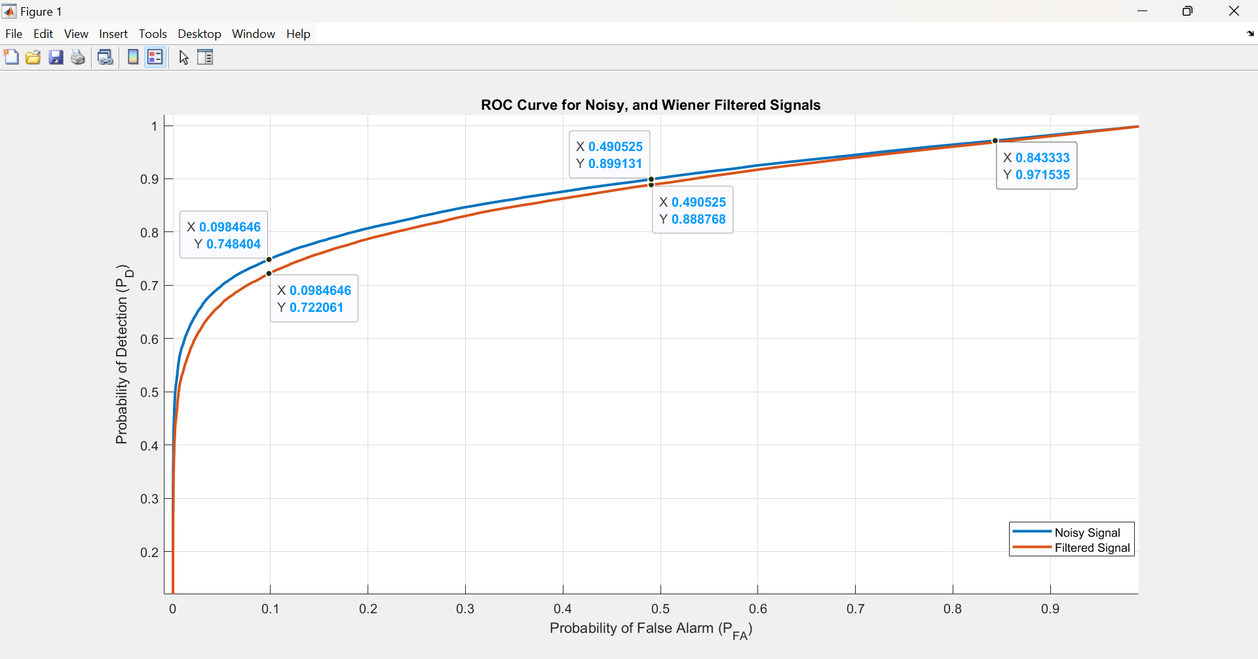
RESULTS - MATLAB
Receiver Operating Characteristics (ROC) Curve

Slide 24
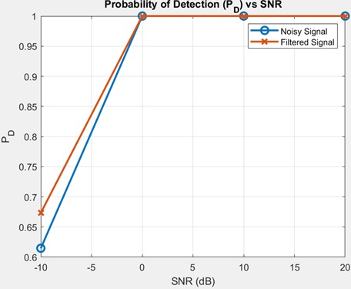
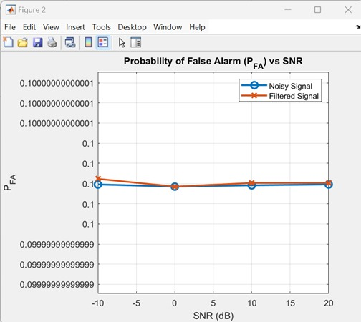
RESULTS - MATLAB
Plots of Pd and Pfa for Wiener Filtered Signal

Slide 25
CONCLUSION
Developed an Enhanced Non-Coherent Neyman–Pearson (NCNP) Detector with Cognitive Radio for efficient 5G spectrum utilization.
Ensures reliable communication by prioritizing emergency services with high detection accuracy and minimal false alarms.
Implemented using USRP-2901 and LabVIEW for real-time spectrum sensing.
The system is scalable and adaptable, making it suitable for disaster management scenarios.
Future enhancements include Spectrum allocation, interference suppression and support for multiple cognitive users in dynamic environment.

Slide 26
REFERENCES
[1] D. Jiang, J. Hu, Y. Zhang, L. Wang, and S. Xu, (2024), "Enhancing 5G Spectrum Sensing: Noncoherent Neyman–Pearson Detector Design and Interference Suppression Method," IEEE Transactions on Instrumentation and Measurement, vol. 73,no.2 , pp. 1-15.
[2] Sandip B. Shrote and Sadhana D. Poshattiwar, (2024), "Dynamic Spectrum Sensing for 5G Cognitive Radio Networks Using Optimization Technique," IEEE Journal of Electrical Systems, vol. 20, no. 3, pp. 1221-1231.
[3] J. Manco and I. Dayoub, (2024), "Experimental Assessment of Spectrum Sensing Under Time-Varying Channels for Cognitive Radio," IEEE Sensors Letters, vol. 8, no. 8, pp. 1-4.
[4] Z. Mohammadi and A. Zaimbashi, (2024), "Parallel Multiband Spectrum Sensing in LTE-based Cognitive Radios," IEEE Transactions on Vehicular Technology, vol. 73, no. 9, pp. 13340-13351, doi: 10.1109/TVT.2024.3391694
[5] K. Wang, G. Ma, Y. Ma, B. Feng, and B. Ai, (2024), "Spectrum Sensing Based on the Difference Between the Maximum Eigenvalue and the Geometric Mean of the Eigenvalue," IEEE Transactions on Vehicular Technology, vol. 25, no. 4, pp. 11-21. doi: 10.1109/TVT.2024.3393562.

Slide 27
REFERENCES
[6] Mohammed Mehdi Saleh, Ahmed A. Abbas, Ahmed Hammoodi, (2021), “5G cognitive radio system design with new algorithm asynchronous spectrum sensing,” Bulletin of Electrical Engineering and Informatics, vol.10, no.4, pp. 2046-2054.
[7] J. Divya Lakshmi and L. Rangaiah, (2019), “Cognitive radio principles and spectrum sensing,” International Journal of Engineering and Advanced Technology (IJEAT), vol.8, no.6, pp. 4294-4298.
[8] Kamal Nayanam,Vatsala Sharma, (2024), “Cognitive Radio Based Enhanced Compressive Spectrum Sensing Technique for 5G Adhoc Networks,” International Journal of Engineering Research & Technology (IJERT), vol.13, pp. 2278-0181.
[9] T. Mounika, A. Sai Suneel, (2021), “Cooperative Spectrum Sensing Based Cognitive Radio System for 5G Communication,” Nat. Volatiles & Essent. Oils, vol.8, pp. 5236 – 5245.
[10] M. Varun1, C. Annadurai, (2022), “Intelligent Spectrum Sensing Using Optimized Machine Learning Algorithms for Cognitive Radio in 5G Communication,” Journal of Internet Technology, vol. 23, pp. 827-836.

